Slide 1

Machine Learning for Developers Assignment 2 Muhamad Shazwandi 2181263A
What will be covered:
Exploratory Data Analysis
Feature Engineering
Data Cleaning
Encoding, Scaling & Preprocessing
Training Machine Learning Models
Cross Validation
Hyperparameter Tuning
Notes:
Gd eve im name ill be presenting my project for MLDV these are the things I will be going through today

Slide 2
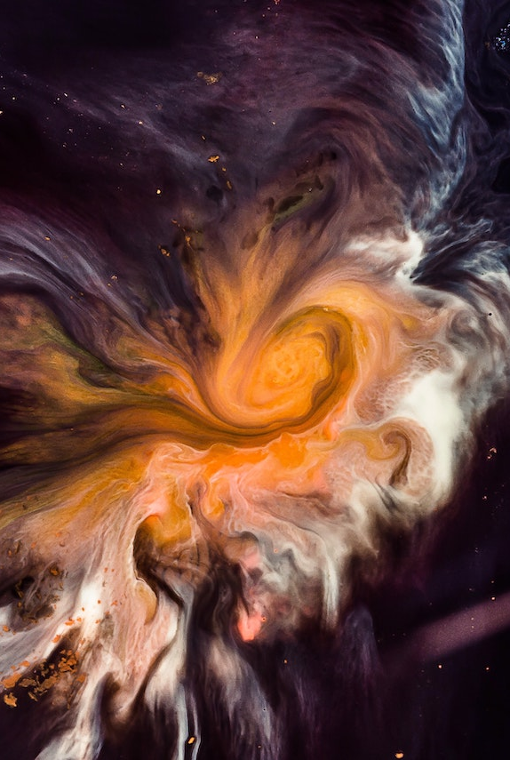
Project Brief
The Spaceship Titanic was an interstellar passenger liner launched a month ago. With almost 13,000 passengers on board, the vessel collided with a spacetime anomaly that cause almost half the passengers to be transported into an alternate dimension.
The Dataset is split into training and testing dataset. Training having 8693 entries while testing has 4277. In those dataset contains 6 continuous features, 4 categorical features and 3 descriptive features
Notes:
Spaceship titanic travelling through space and spaceship hit a spacetime anomaly and almost half got transported to alternate dimension to help[ rescue and save the lost passengers we will be building a model to predic passengers who got transported.

Slide 3
Column Name | DataType | Description | Example
PassengerId | Object | A unique Id for each passenger. Each Id takes the form gggg_pp where gggg indicates a group the passenger is travelling with and pp is their number within the group. People in a group are often family members, but not always. | 0001_01
HomePlanet | Object | The planet the passenger departed from, typically their planet of permanent residence. | Europa
CryoSleep | Object | Indicates whether the passenger elected to be put into suspended animation for the duration of the voyage. Passengers in cryosleep are confined to their cabins. | False
Cabin | Object | The cabin number where the passenger is staying. Takes the form deck/num/side, where side can be either P for Port or S for Starboard. | B/0/P
Destination | Object | The planet the passenger will be debarking to. | TRAPPIST-1e
Age | Float64 | The age of the passenger. | 39.0
VIP | Object | Whether the passenger has paid for special VIP service during the voyage. | True
Expenditure (RoomService, FoodCourt, ShoppingMall, Spa, VRDeck | Float64 | Amount the passenger has billed at each of the Spaceship Titanic's many luxury amenities. | 3329.0
Name | Object | The first and last names of the passenger. | Maham Ofracculy
Transported | Boolean | Whether the passenger was transported to another dimension. This is the target, the column you are trying to predict. | True
Notes:
These is the data dictionary. I would want to point out the PassengerId and Cabin further. PassengerId has a format of group number and number within said group. Being in group number 1 and being the first person in group number 1 Cabin has a format of Deck/Num/Side. B being the deck number 0 and on Port side. This is important for future feature engineering

Slide 4
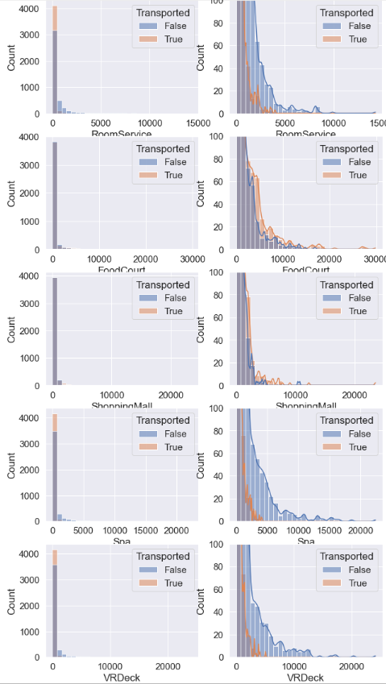
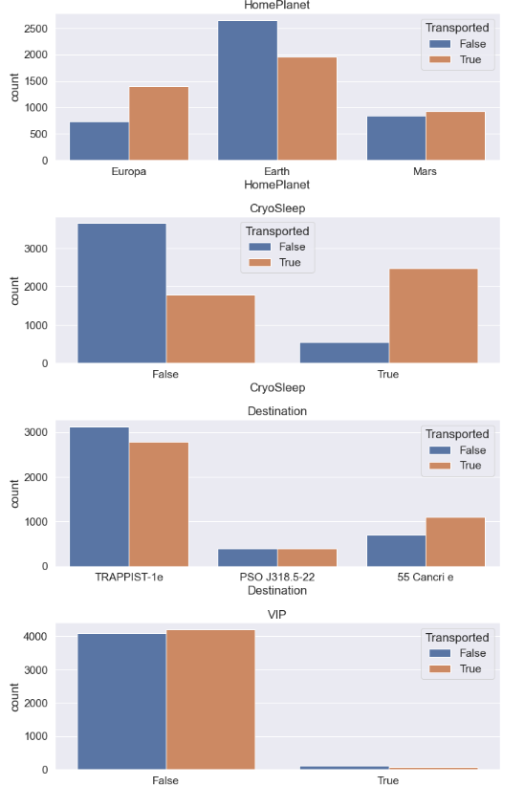
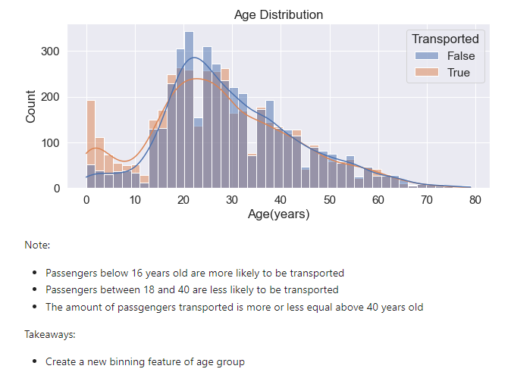
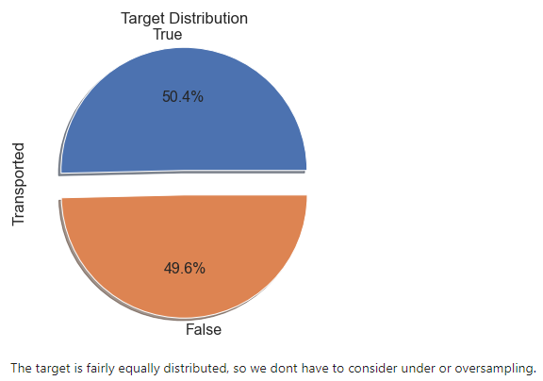
Data Exploration(Expenditure)
Data Exploration
Data Exploration
Data Exploration (Categorical)
Notes:
Passengers are mostly spending little to none during the trip
Small percentage of passengers are outliers spending more than 10k
The amount spent by passengers drops significantly before 5000
Takeaway:
Create a new feature tracking the total spendings of all passengers
Create a new feature to see if passengers spend anything during the trip or none at all
Normalize to reduce skew
Notes:
Majority of the passengers are not VIP, and VIP seems to not be an important factor to whether a passenger is transported or not.
In contrast, CryoSleep appears to be a useful feature.
Takeaway:
Consider dropping the VIP column to prevent overfitting
Notes:
Passengers below 16 years old are more likely to be transported
Passengers between 18 and 40 are less likely to be transported
The number of passengers transported is more or less equal above 40 years old
Takeaway:
Create a new binning feature of age group
The target is equally distributed, so we don’t have to consider under or oversampling.

Slide 5
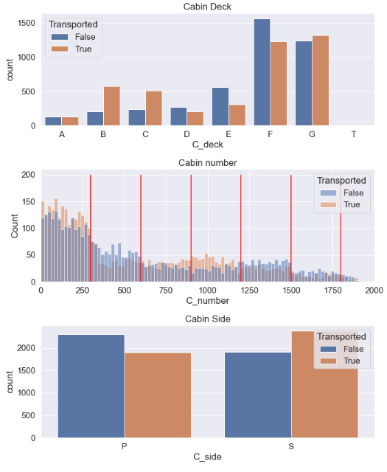
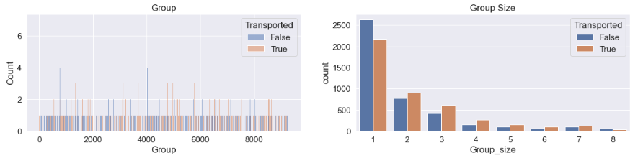
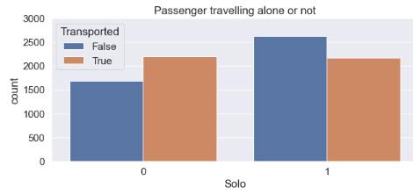
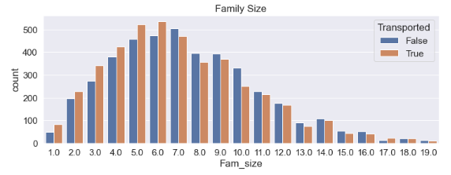
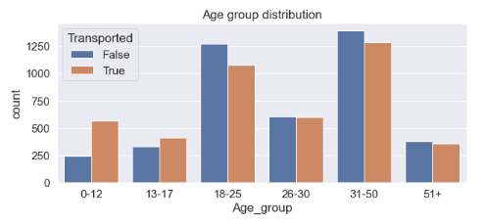
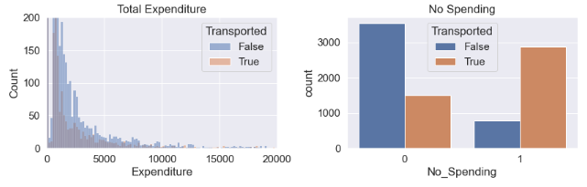
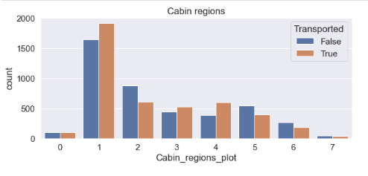
Feature Engineering
Feature Engineering
Feature Engineering
Feature Engineering
For Cabin:
- Extract the cabin deck, number and side from the Cabin column.
- Cabin number binned by values of 300 cabins
For Age:
- I will be binning them into 6 new age groups
For Expenditure:
- Create two new features that tracks Total Expenditure and identify those who don’t spend at all.
For Groups and Group Size:
- Extract Groups and Group Size from
the PassengerId
For Travelling Solo:
- After extracting the group sizes find those passengers that has a group size of 1 and classify them as solo travellers.
For Family Size:
- Extract last names of passengers
- Group those with same last names together
- Count the number of family members.
Notes:
It can produce new features for both supervised and unsupervised learning, with the goal of simplifying and speeding up data transformations while also enhancing model accuracy
Note:
Group feature appers to be too big of a cardinality to be of use in our model and would explode the number of dimensions with one-hot encoding
The Group size however would be useful.
Takeaway:
Compress Group size features further by seeing if passengers travel alone or with someone else. Those travelling alone tend to be transported less often than those travelling with someone else

Slide 6
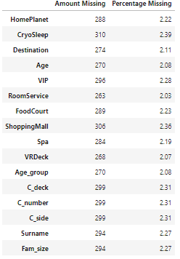
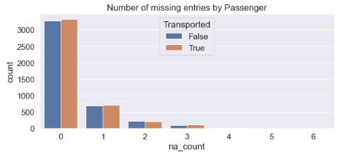
Missing Data
Even though the percentage of the missing values of each features are small, about 25% of all passengers have atleast 1 missing value.
It makes more sense to fill in the missing values than just dropping them
Even though the easiest way to fill in the null values are with median and mode and it will be “good enough”, but to maximize the accuracy of the model we need to look for patterns within the missing data. We can do this by looking at joint distribution of features, e.g. do passengers from the same group have the same family name?

Slide 7
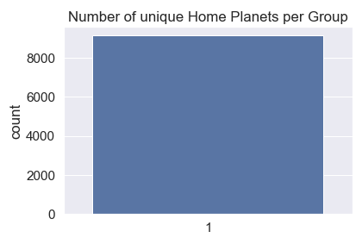
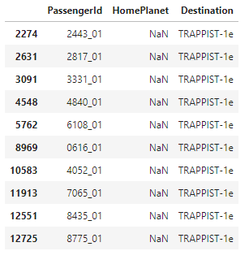
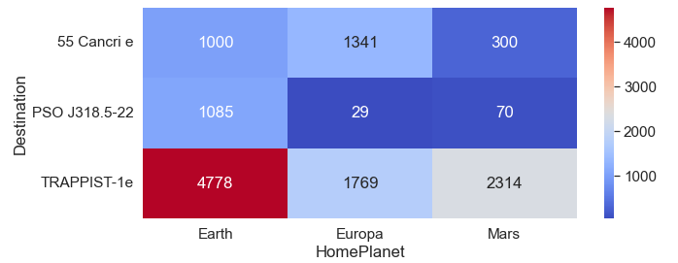
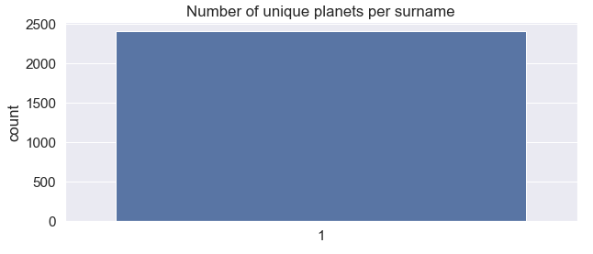
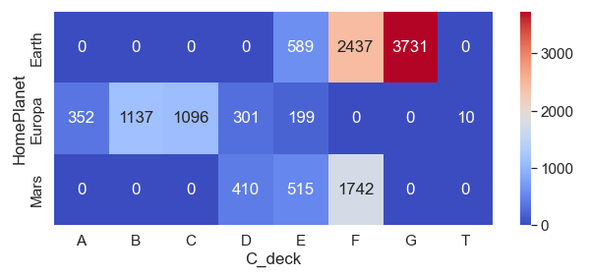
HomePlanet
Notes:
Here are the different joint distribution(groupby) comparing homeplanet with different features to see if there is any pattern to use to fill in missing values.
So the red highlights are the features of the joint distribution where I can input the missing values with high confidence.
To give an example we will look at number of unique home planets per group this shows that everyone from the same group comes from the same planet hence we can input missing values based on other group members with known home planets.

Slide 8
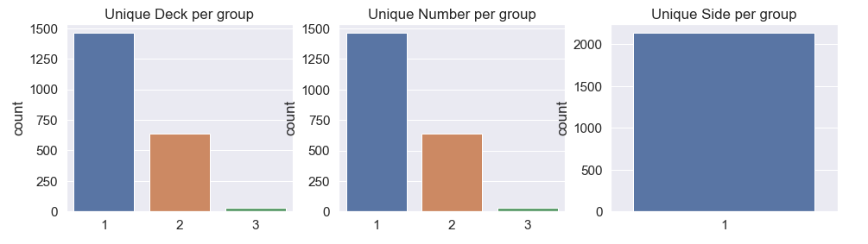
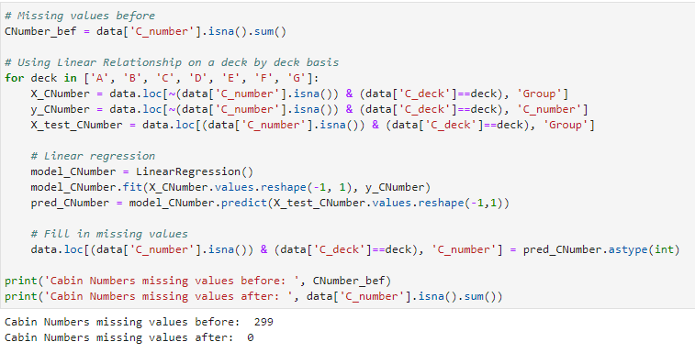
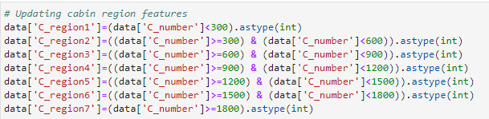
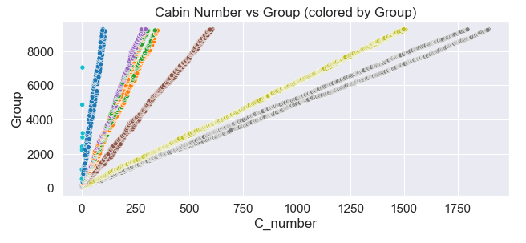
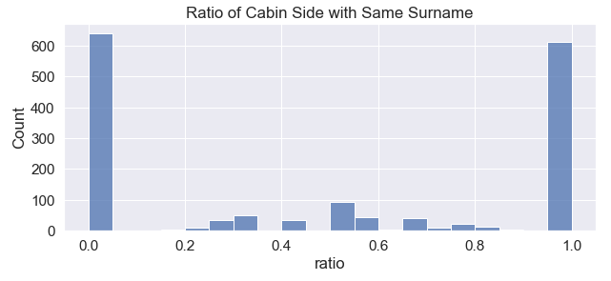
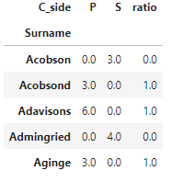
Cabin
Notes:
The same was done with the cabin features but only diff is with cabin number. As you can see the graph on the bottom right (Press button). There seems to be a linear relationship between the cabin number and group number on a deck-by-deck basis. I will be using linear regression on a deck-by-deck basis to predict the approximate missing cabin number. Something to also note whatever feature engineering done will be updated once missing values has been filled in

Slide 9
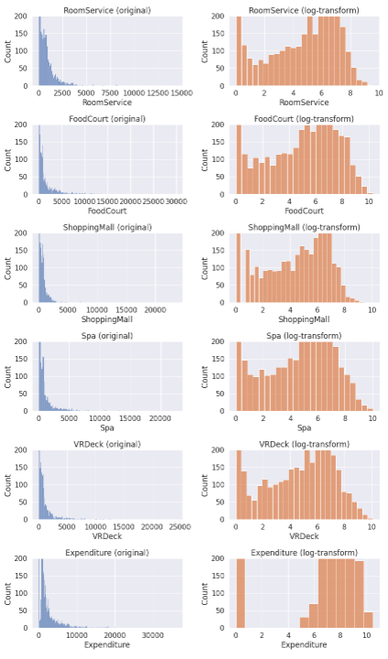
Data Preprocessing
Data PreProcessing
Column | Original Input | Output
CryoSleep | True | False | 1 – True 0 – False
HomePlanet | Earth | Europa | Mars | 0 – Earth 1 – Europa 2 – Mars
Destination | 55 Cancri e | PSO J318.5-22 | TRAPPIST-1e | 0 – 55 Cancri e 1 – PSO J318.5-22 2 – TRAPPIST-1e
C_Side | P for port | S for Starboard | 0 – Port 1 - Starboard
C_Deck | A – G & T | 0 ,1, 2, 3, 4, 5, 6, 7 in order
C_region | Region 1 - 7 | 0 ,1, 2, 3, 4, 5, 6, 7 in order
Performing logarithm transform to reduce skew, especially with large outliers present in the Expenditures features.
Apply LabelEncoder to categorical features to convert strings to numerical values.

Slide 10
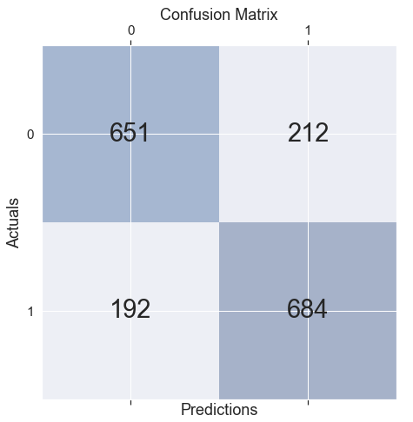
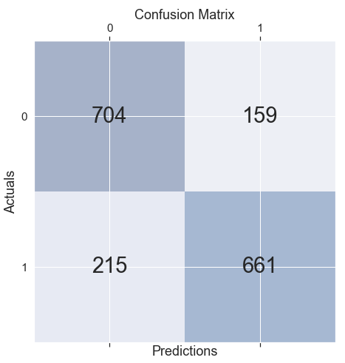
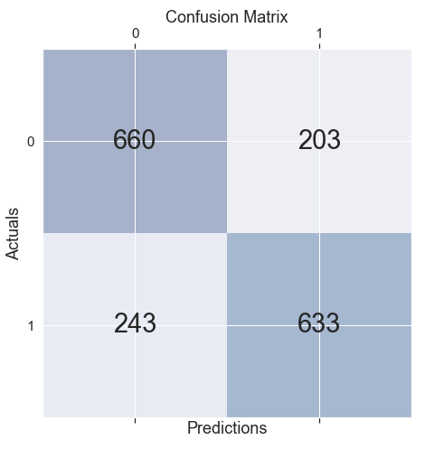

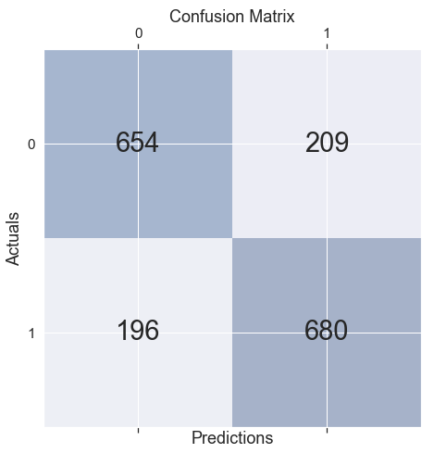

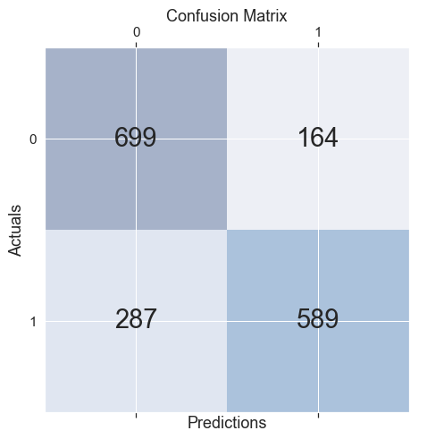
Model
Logistic Regression
Random Forest
KNeighbors Classifier
NaiveBayes
Score: 0.768
Kfold: 77.62% +-1.69%
Score: 0.785
Kfold: 80.3% +-1.61%
Score: 0.744
Kfold: 75.57% +-1.62%
Score: 0.741
Kfold: 73.83% +-1.39%
SVC
Decision Tree
LGBM
I will first be running the models with default hyperparameters to compare the results.
And to have a more accurate score of the model I ran Kfold of 10 iterations.
As you can see LGBM has the highest score of 0.8 and 81.09% with a standard deviation of 1.22% after Kfold.
Score: 0.767
Kfold: 77.96% +-1.69%
Score: 0.730
Kfold: 74.68% +-1.82%
Score: 0.800
Kfold: 81.09% +-1.22%
Notes:
I will be performing hyperparameter tuning to see if there will be an increase in accuracy.
I will be performing hyperparameter tuning on 2 of my highest performing models. (LGBM and RandomForest)

Slide 11
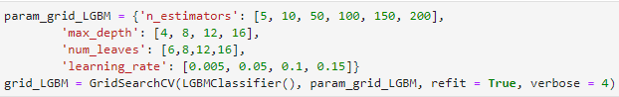
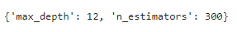
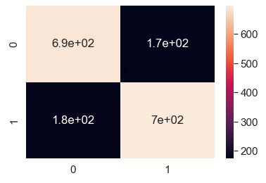
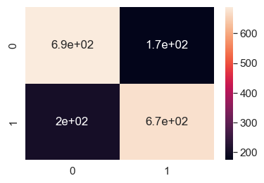
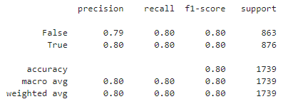
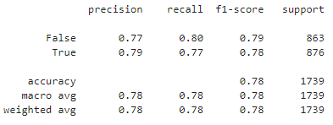
GridSearchCV
Summary
Light Gradient Boosting Machine
Random Forest
Param Grid:
Param Grid:
Scores:
Scores:
The accuracy score does not seem to improve after running GridSearch.
Before Grid:
0.8
After Grid: 0.8
The accuracy of RandomForest also did not see an increase.
Before Grid:
0.785
After Grid: 0.78
I will be performing GridSearch for two of the highest performing model (LGBM and Random Forest) to see if there will be an increase of accuracy.
Notes:
The score did not see an increase most probably because GridSearch did not do a thorough enough check for the best params either through my inputs or just the limitations of GridSearch. So to counter this I will be performing randomsearch instead but only to LGBM since its my highest scoring model.

Slide 12
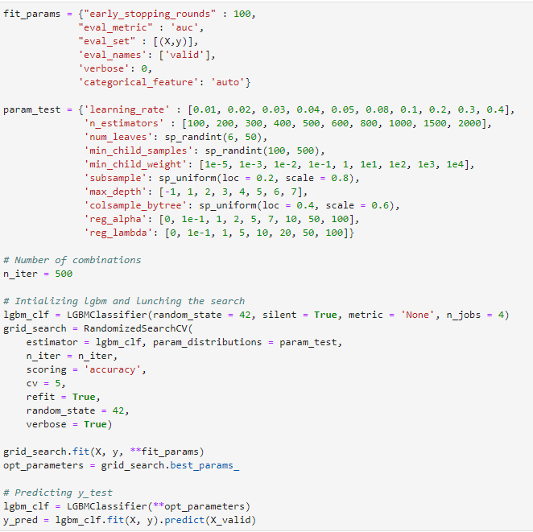
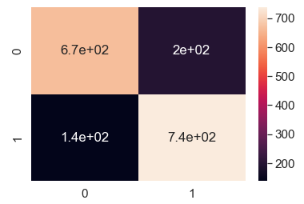
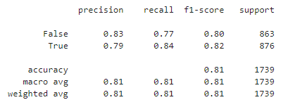
RandomSearch
After random search performed with more parameter tested, the model finally see a 1% increase.
Something to note is that the increase in runtime is significant as compared to GridSearchCV, in real life application runtime is an important factor to consider.
But in this submission, I am just focusing on achieving the highest score possible for my model , hence I will be using the parameters after running RandomSearchCV.

Slide 13
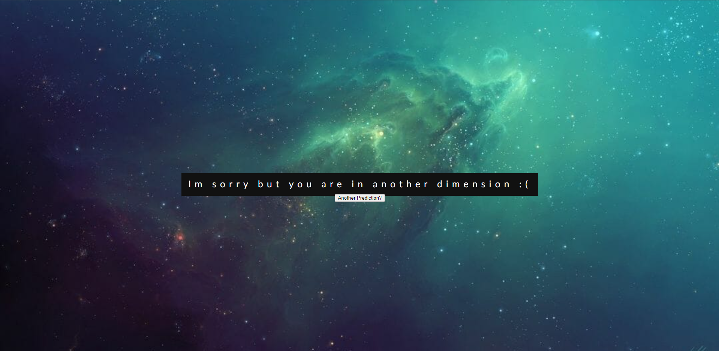
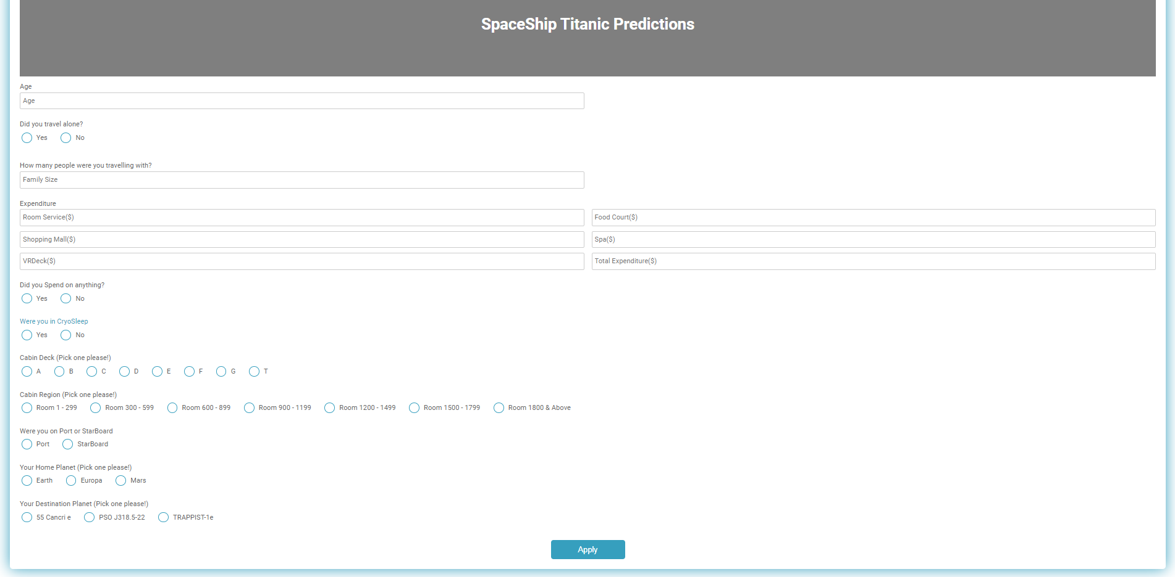

Flask Deployment
TRANSPORTED
INPUT
NOT TRANSPORTED
Notes:
Don’t worry about it being too small ill show a live demonstration later. So users will need to input their features in the form and press submit so depending on wether their prediction is transported or not they will be directed to a page saying that theyre safe or not.

